Slide 1

Support Vector Machine: Fundamental Concepts
Professor Bo Liu
James Watt School of Engineering

Slide 2
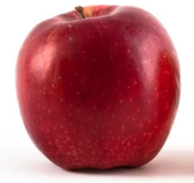
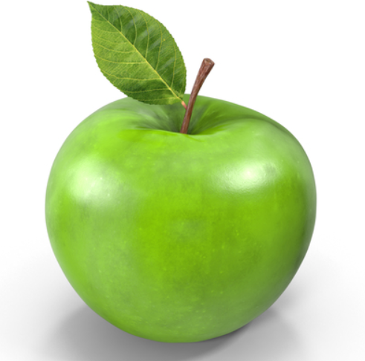
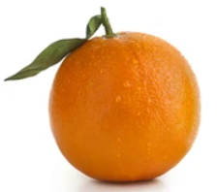
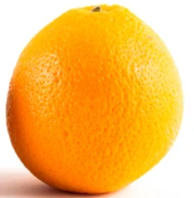
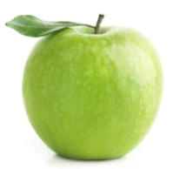
Classification
An example of classification
Learn to recognize apple or orange
Classification: to learn a classifier that can best separate the training data.
Label
apple
Training data
apple
ML model
color
orange
orange
…
…
shape
The test data is predicted as apple.
Test data
To predict it is apple or orange.

Slide 3
SVM: an overview
Applications of SVM
Applications | Input | Label
Recommendation System | Ratings, clicks, or likes | Preference score
Fraud detection | Account transaction history | Money Laundering account?
Tumor diagnosis | Medical images | Tumor nor not?
Handwriting recognition | Handwriting images | Digits
… | … | …

Slide 4
SVM: an overview
Support Vector Machine (SVM)
A very popular/influential classification algorithm
Backed by solid theoretical groundings
A hyperplane-based classifier
margin boundaries
hyperplane
separation margin
class +1
class -1

Slide 5
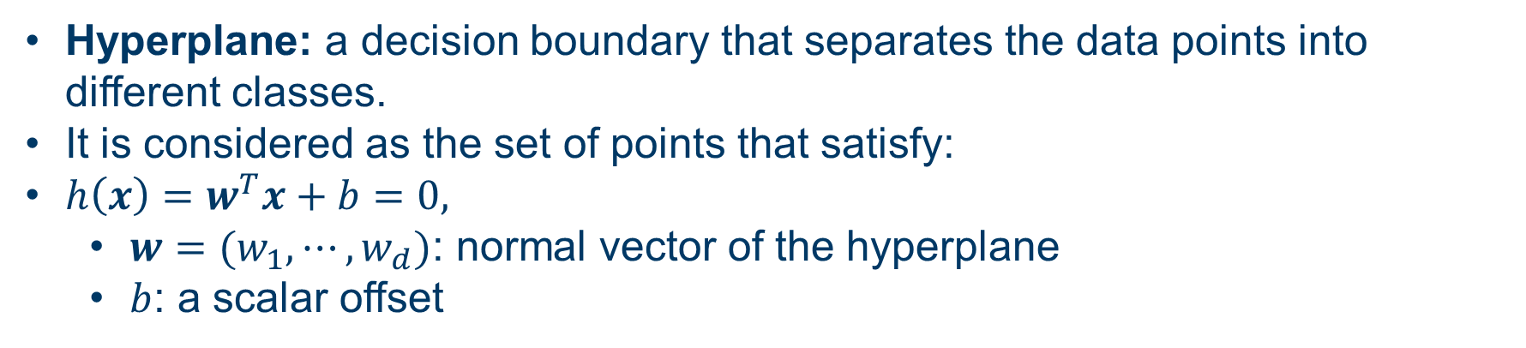
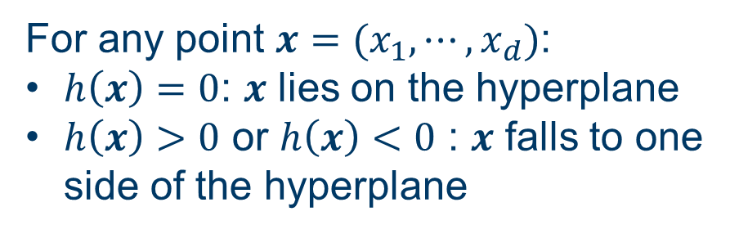



Hyperplane
Hyperplane: a decision boundary that separates the data points into different classes.
It is considered as the set of points that satisfy:
${h\left(x\right)=w}^{T}x+b=0,$
  $w=(w_{1},⋯,w_{d})$: normal vector of the hyperplane
  $b$: a scalar offset
normal vector
$$w^{T}x+b=0$$
For any point $x=(x_{1},⋯,x_{d})$:
$h\left(x\right)=0$: $x$ lies on the hyperplane
$h\left(x\right)>0$ or $h\left(x\right)<0$ : $x$ falls to one side of the hyperplane
class +1
class -1
$$w^{T}x+b>0$$
$$w^{T}x+b<0$$

Slide 6
Separating hyperplane
Separating hyperplane: in SVM, we use hyperplanes to separate datasets
A hyperplane splits the original space into two half-spaces.
In 2-dimensional space: a line
In 3-dimensional space: a plane
not hyperplane
separating hyperplane in 2D
separating hyperplane in 3D

Slide 7
The best separating hyperplane
What is the best separating hyperplane?
Linearly separable: there exists a hyperplane that can separate the dataset
For linearly separable dataset, there exist many other separating hyperplanes (indeed, infinitely many) can separate it, which one is the best?
best hyperplane
small margin
large margin
Intuitively, we want the hyperplane with the maximum margin

Slide 8
The best separating hyperplane
What is the best separating hyperplane?
Linearly separable: there exists a hyperplane that can separate the dataset
For linearly separable dataset, to separate the data, there exist many other separating hyperplanes. Which one is the best?
best hyperplane
small margin
large margin
SVMs use the maximum margin principle
  – Finds the hyperplane with maximum separation margin on the training data
Large margin leads to good generalization on the test data

Slide 9

Support vectors
All the points that have the minimum distance to the hyperplane are called support vectors.
In SVM, the classifier is only determined by the support vectors.
There’s no impact if other data are removed.
$$H$$
class +1
support vectors
class -1
This is the reason why it is named as Support Vector Machines (SVMs).

Slide 10




Thanks!
#UofGWorldChangers
@UofGlasgow

